Slide 1
Ocean Currents Analysis ?? Energy B16-2
Department :
Operations
Client :
?? Energy
Author :
??
Date: 12 Apr 2020

Slide 2
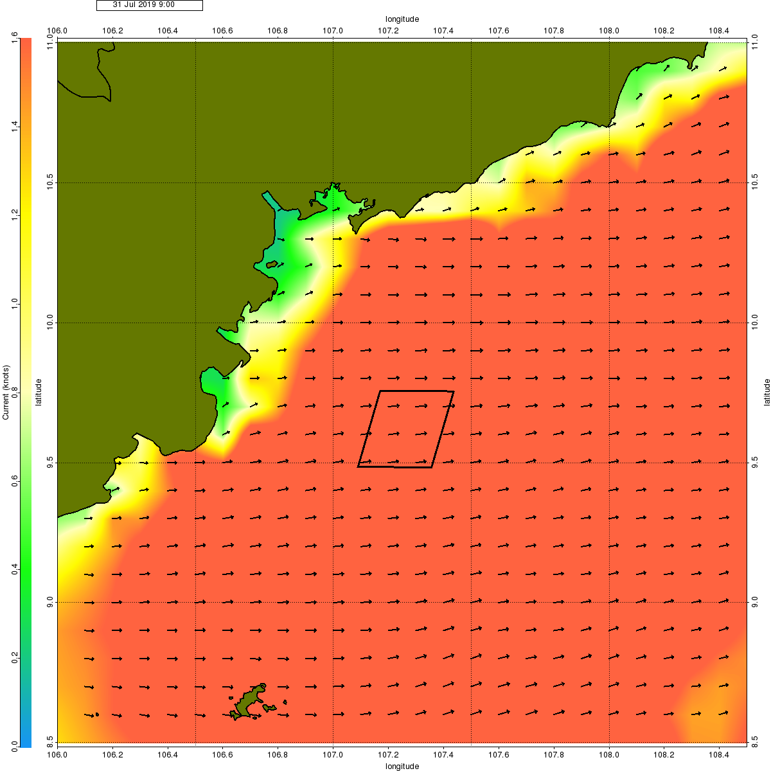
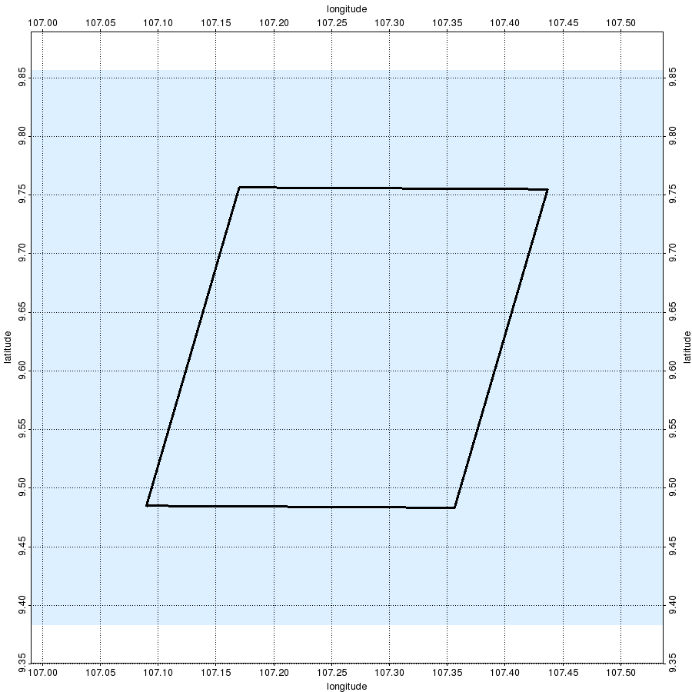
Executive Summary
?? Energy B16-2 Survey Period: 2020
Historical Combined Currents Analysis: 2015 - 2019
Regional combined currents shown on animated map display over the planned survey period.
Circulation and tidal currents extracted at 1 selected locations for cross-plot analysis
Point Analysis Locations:
Name | Latitude | Longitude
PC-1 | 9.62ºN | 107.26ºE
Point Analysis Results:
Combined Currents:
Maximum Strength:
Average Strength:
Dominant Azimuth:
2.53 Knots
0.93 Knots
ENE
PC-1
Tidal Currents:
Maximum Strength:
Dominant Azimuth:
1.594 Knots
West-East

Slide 3
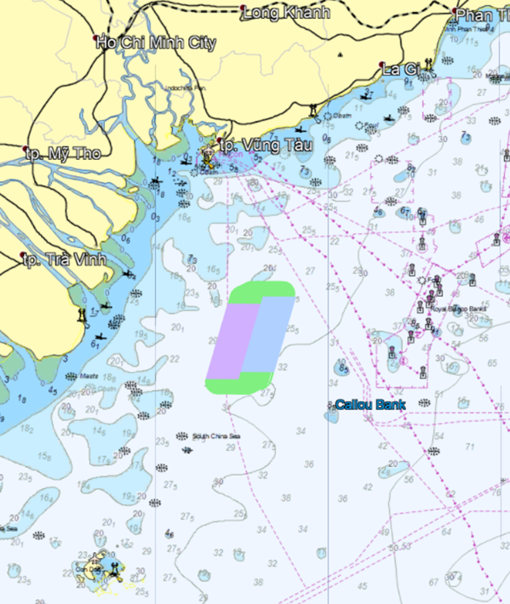
Currents Analysis ?? Energy B16-2 Introduction
The survey is scheduled for 2020
Ocean currents analysis for this job consists of
Regional and survey area animations of currents, 1 Jun to 1 Aug, for the years 2018 and 2019.
Detailed analysis of currents at 1 points in the survey area, and for the years 2015 - 2019
Name | Latitude | Longitude
PC-1 | 9.62ºN | 107.26ºE

Slide 4
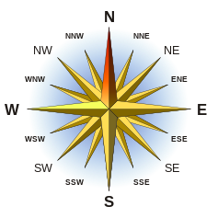
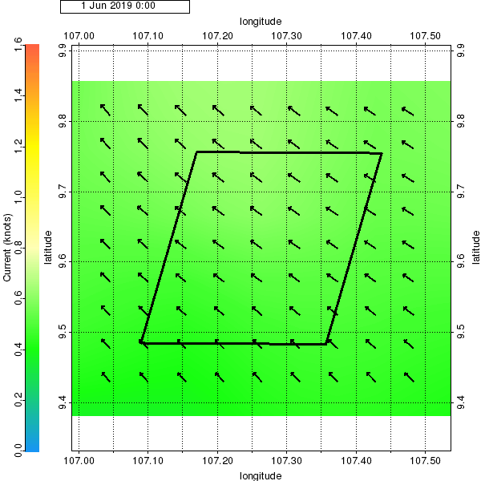
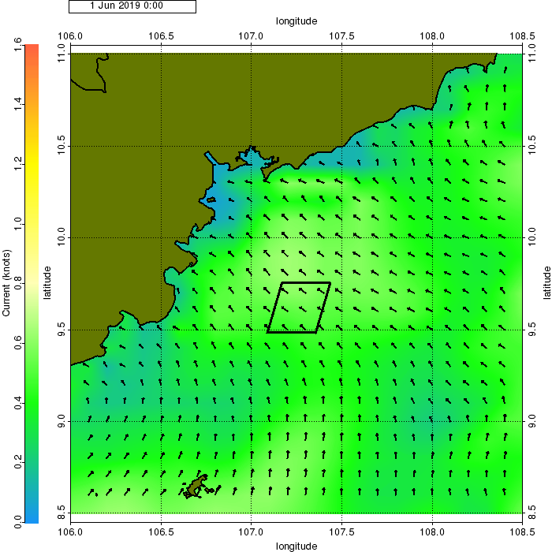
Current Analysis Movie - Combined Regional Currents, 1 Jun to 1 Aug 2019
This slide contains movie displays of regional currents. Use Slide Show view to play the movies.
The current strength around the survey area is up to ~2.5 Knots.

Slide 5
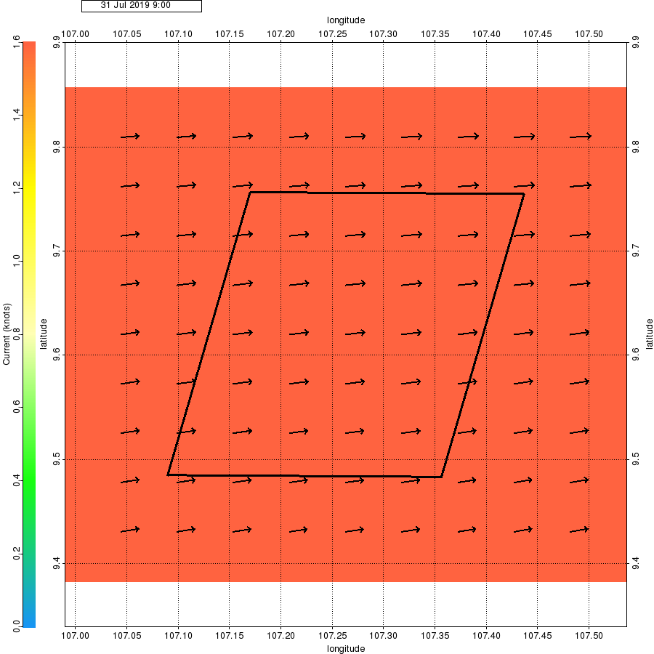
Current Analysis Map - Combined Regional Currents at Peak Strength on 31 Jul 2019
This slide shows maps of the regional currents at peak strength (at the selected point locations).
The current strength around the survey area is up to ~2.5 Knots.

Slide 6
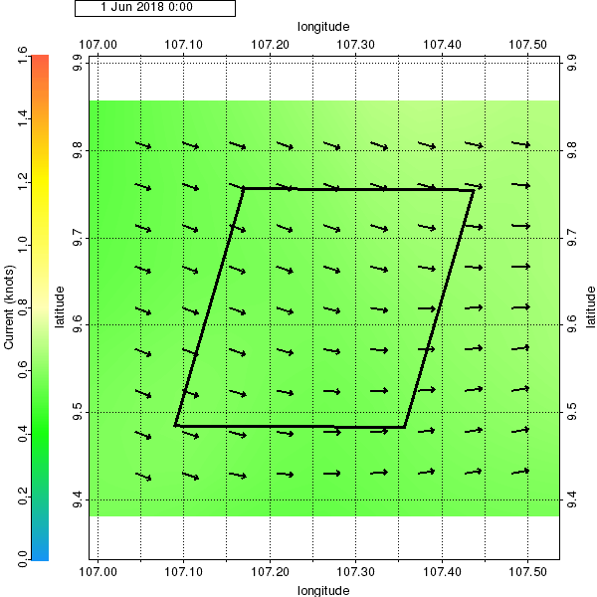
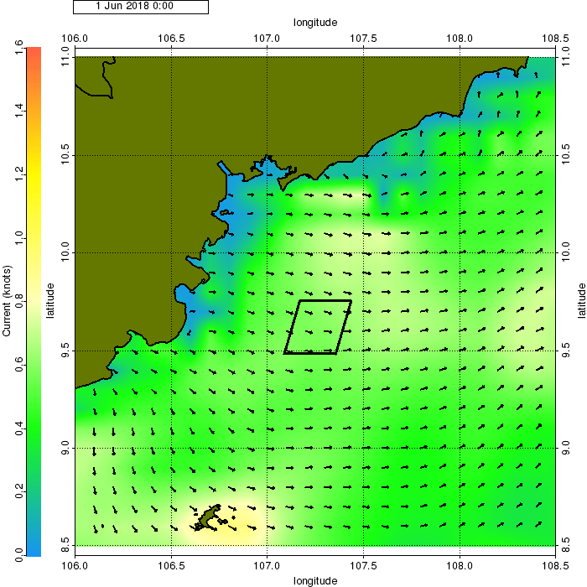
Current Analysis Movie - Combined Regional Currents, 1 Jun to 1 Aug 2018
This slide contains movie displays of regional currents. Use Slide Show view to play the movies.
The current strength around the survey area is up to ~2.5 Knots.

Slide 7

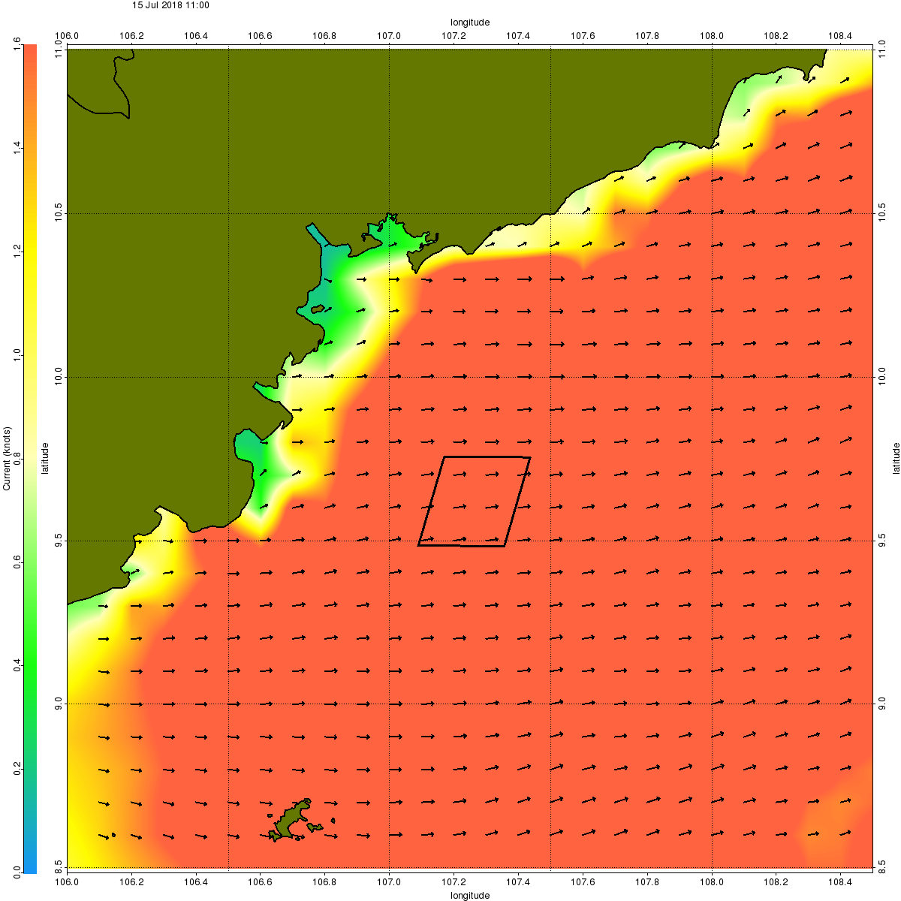
Current Analysis Map - Combined Regional Currents at Peak Strength on 15 Jul 2018
This slide shows maps of the regional currents at peak strength (at the selected point locations).
The current strength around the survey area is up to ~2.5 Knots.

Slide 8
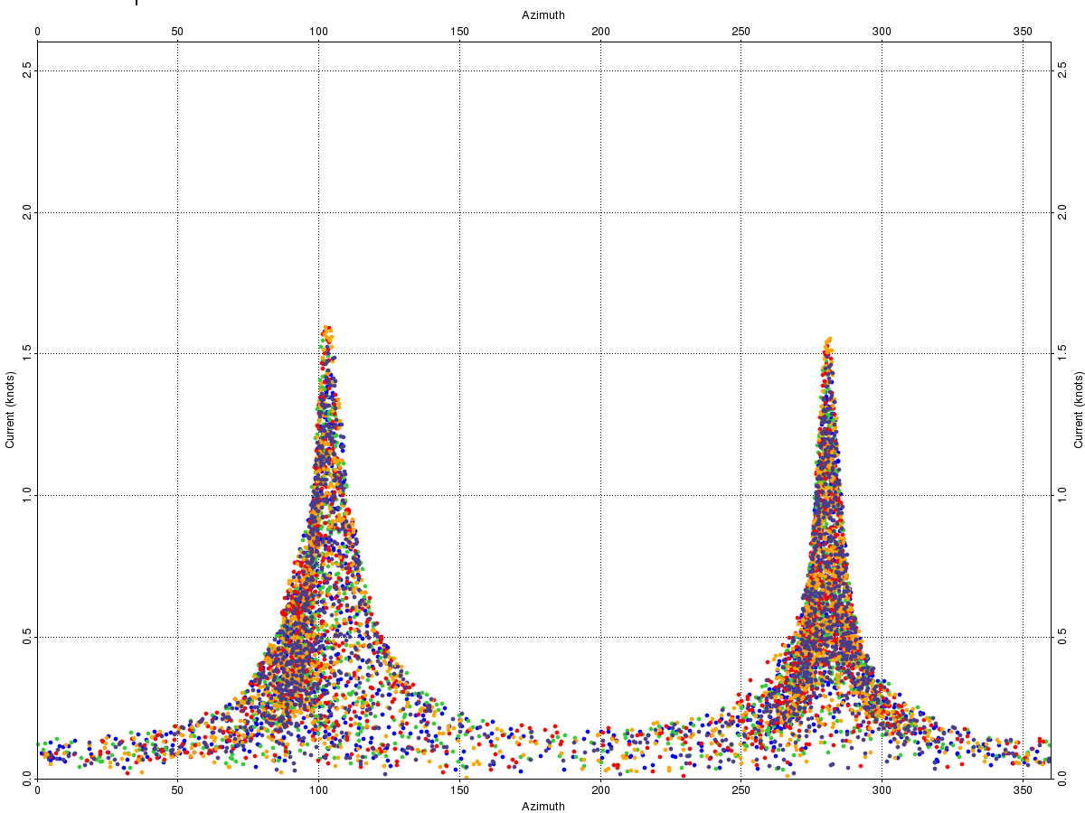
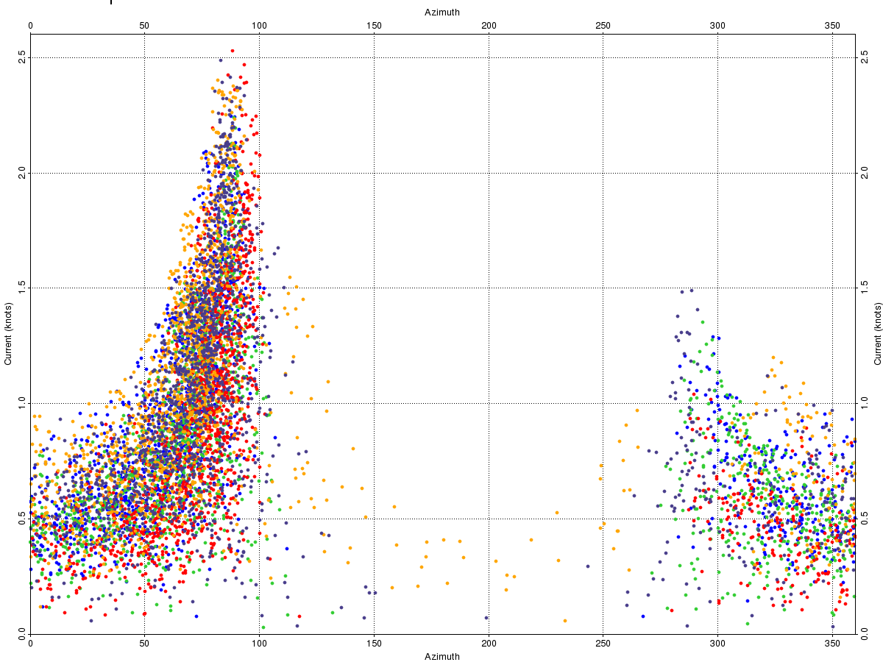
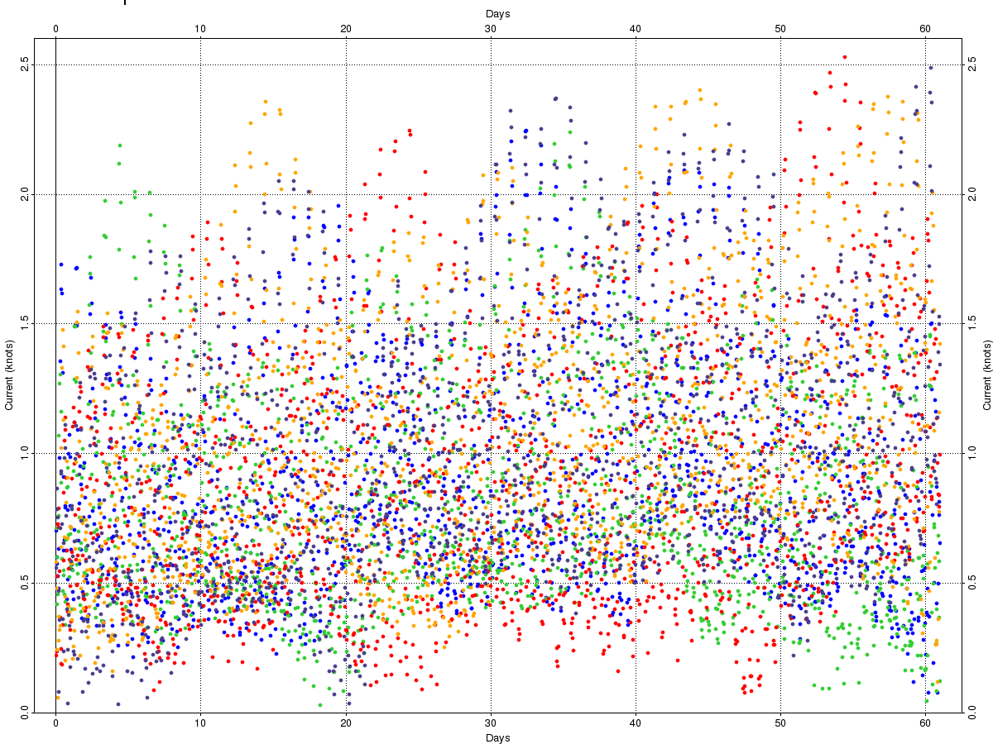
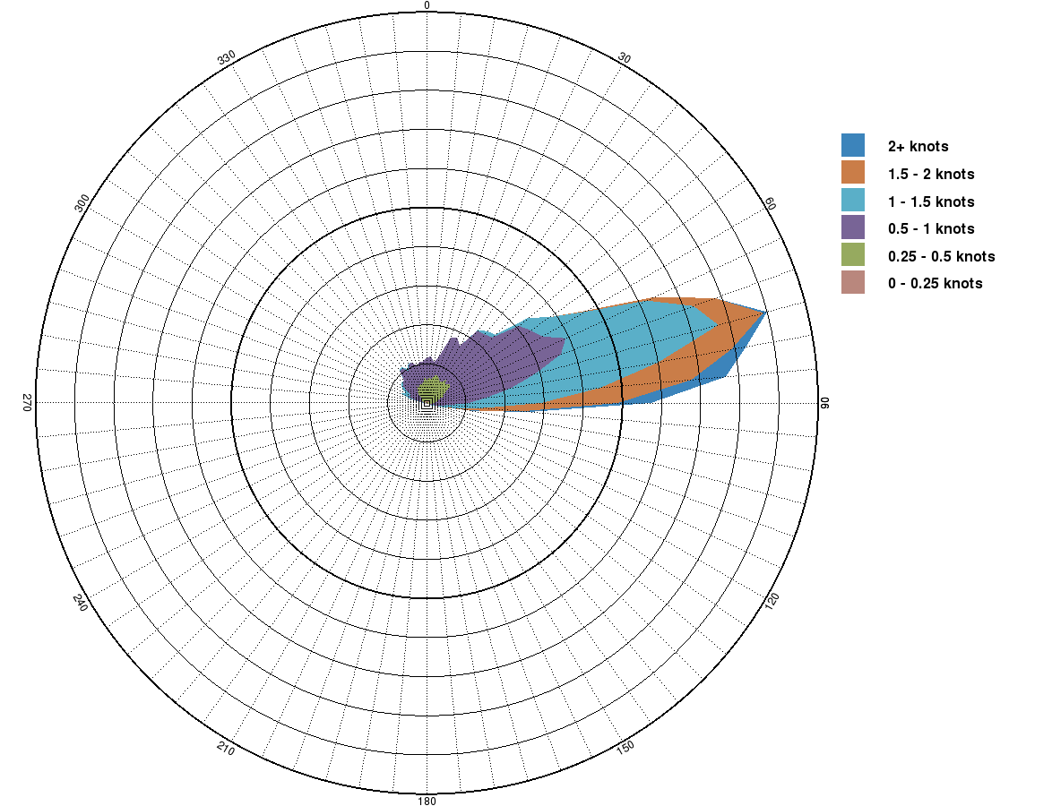
Point Currents Historical currents at reference point PC-1 from 1 Jun to 1 Aug.
2.6
Tidal Currents
(Magnitude vs Azimuth)
2.6
Combined Currents
(Magnitude vs Azimuth)
2.6
Combined Currents
(Magnitude vs Days)
Knots
0.0
Deg
360
0.0
Deg
360
1 Jun
Days
1 Aug
Combined Currents
(Rose Diagram)
2015
2016
2017
Combined Currents:
2018
Maximum Strength:
Average Strength:
Dominant Azimuth:
2.53 Knots
0.93 Knots
ENE
2019
Comb. Mag | 2015 | 2016 | 2017 | 2018 | 2019
Mean | 0.90 | 0.81 | 0.89 | 1.06 | 1.01
Std. Dev | 0.42 | 0.40 | 0.49 | 0.48 | 0.49
Tidal Currents:
Maximum Strength:
Dominant Azimuth:
1.594 Knots
West-East

